Slide 1
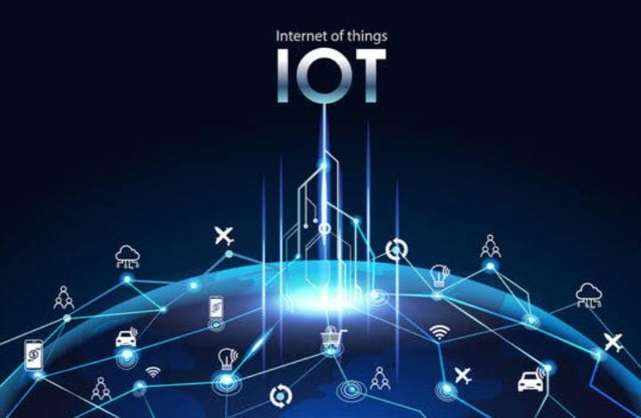
INTERNET OF THINGS
SUBMIT BY : JASPREET KAUR
COURSE :COPA

Slide 2
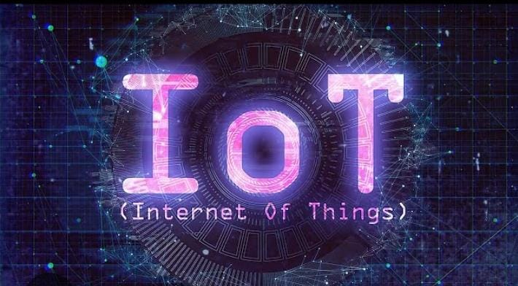
INTERNET OF THINGS
The Internet of Things (IoT) is a technology that connects physical devices to the internet so they can collect, share, and exchange data automatically.

Slide 3
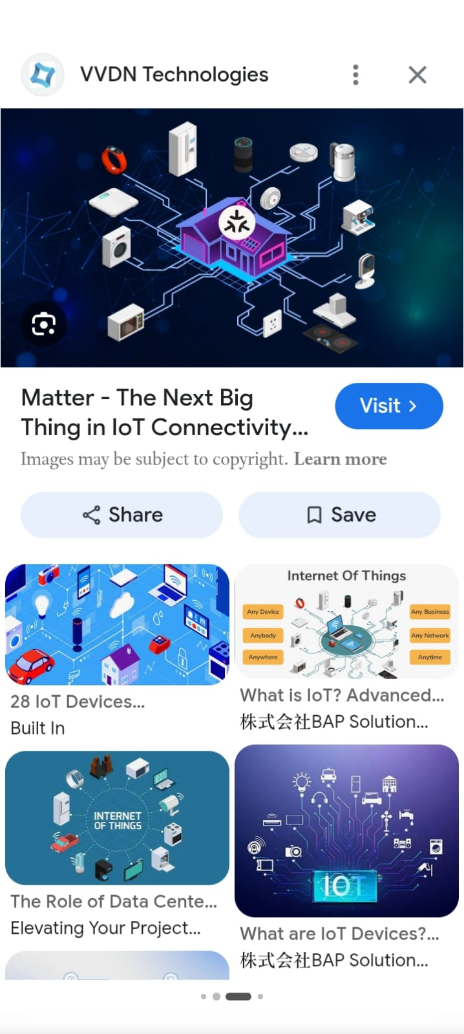
WHAT IS IOT?
IoT is a network of smart devices such as sensors, mobile phones, cameras, and home appliances that communicate with each other through the internet.

Slide 4
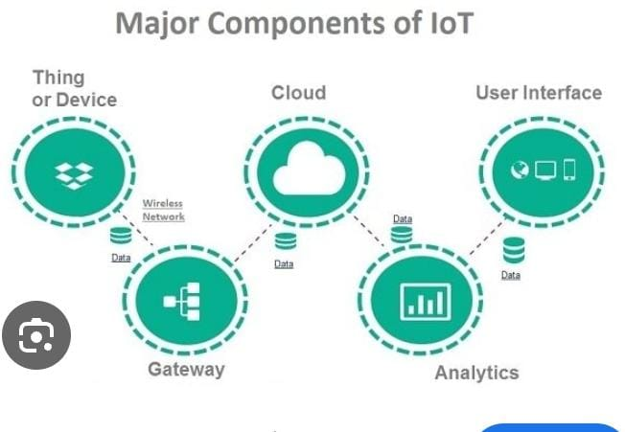
COMPONENTS OF IOT
The main components of IoT are : Sensors – Collect DATA
CONNECTIVITY- Sends data through the internet.
Cloud – Stores and processes data.
Applications – Show information to users.

Slide 5
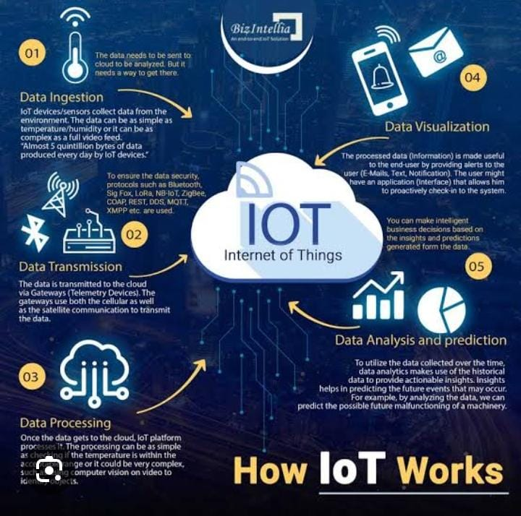
Working of IoT
IoT works by collecting data from sensors, sending it to the cloud, analyzing the data, and then taking automatic actions or displaying results to users.

Slide 6
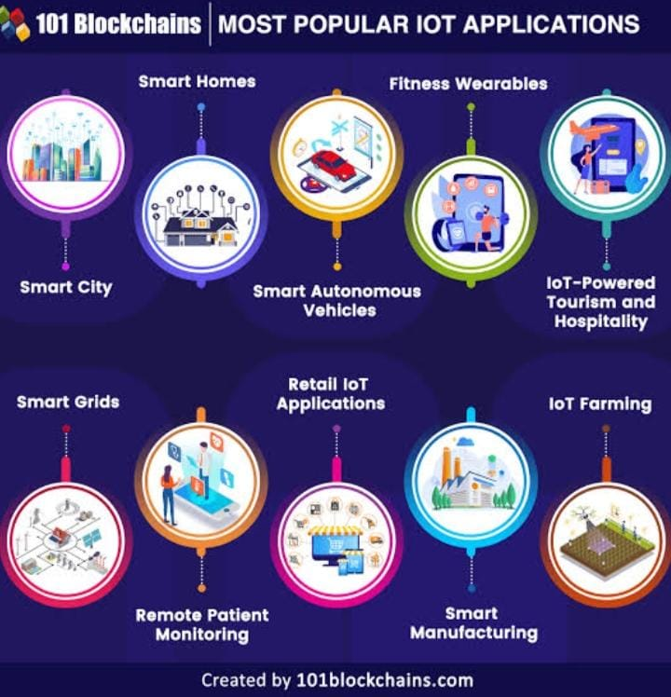
Applications of IoT
IoT is used in many fields such as smart homes, healthcare, agriculture, industries, transportation, and smart cities to improve efficiency and convenience.

Slide 7
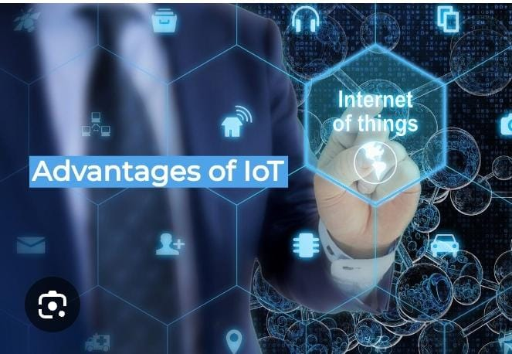
ADVANTAGEs OF IOT
IoT provides automation, saves time and energy, improves productivity, reduces costs, and allows real-time monitoring and control of devices.

Slide 8
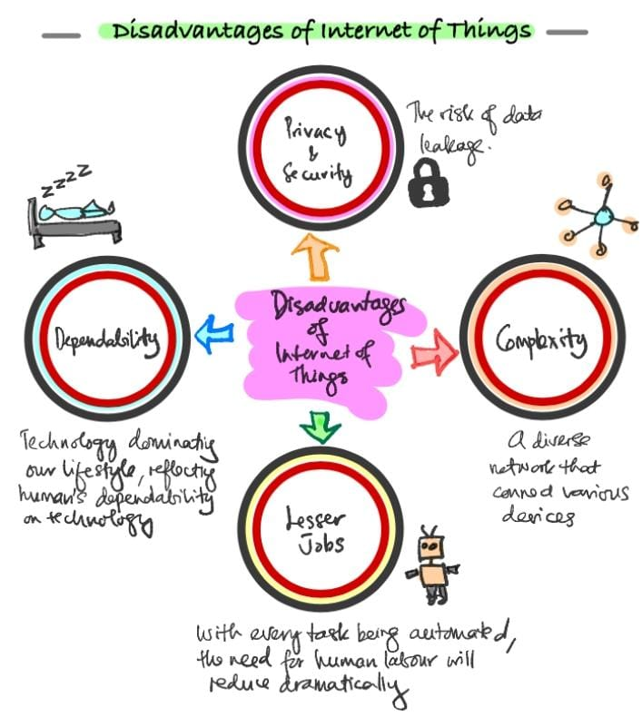
DISADVANTAGES OF IOT
IoT faces challenges such as security risks, privacy concerns, internet dependency, and high installation and maintenance costs.

Slide 9
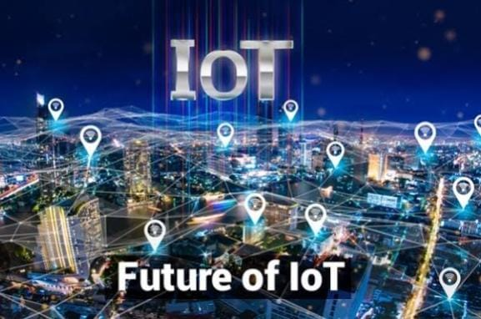
FUTURE SCOPE Of IOT
The future of IoT includes smart cities, smart healthcare, intelligent transportation, AI integration, and advanced automation in every sector.

Slide 10

CONCLUSION
IoT is transforming the way people live and work by making devices smarter, improving communication, and increasing efficiency in daily life.

Slide 11

JASSKAUR20818@GMAIL.COM

